Slide 1
Introduction to Spark Streaming with NiFi & Kafka
Robert Hryniewicz
Data Advocate
T: @RobH8z
E: rhryniewicz@hortonworks.com

Slide 2
Agenda
Streaming Fundamentals
Apache Spark Streaming
Apache Kafka
Apache NiFi
Demo

Slide 3
Streaming Fundamentals

Slide 4








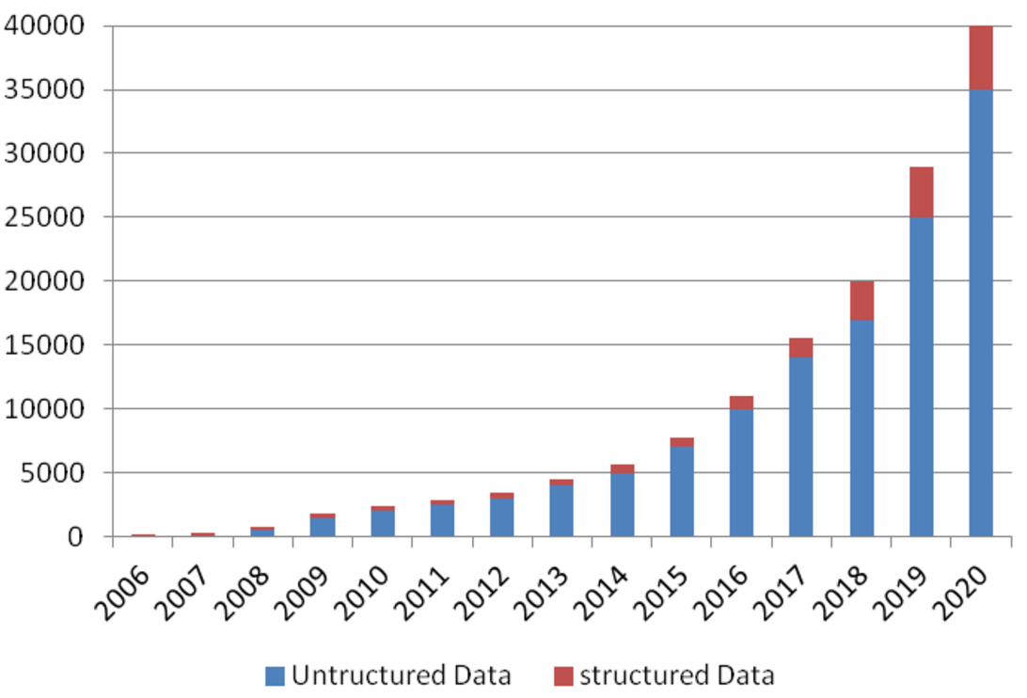
Data Sources
Internet of Anything (IoAT)
Wind Turbines, Oil Rigs, Cars
Weather Stations, Smart Grids
RFID Tags, Beacons, Wearables
User Generated Content (Web & Mobile)
Twitter, Facebook, Snapchat, YouTube
Clickstream, Ads, User Engagement
Payments: Paypal, Venmo
44ZB in 2020

Slide 5


What is Stream Processing?
Batch Processing
Ability to process and analyze data at-rest (stored data)
Request-based, bulk evaluation and short-lived processing
Enabler for Retrospective, Reactive and On-demand Analytics
Stream Processing
Ability to ingest, process and analyze data in-motion in real- or near-real-time
Event or micro-batch driven, continuous evaluation and long-lived processing
Enabler for real-time Prospective, Proactive and Predictive Analytics for Next Best Action
Stream Processing + Batch Processing = All Data Analytics
real-time (now)
historical (past)

Slide 6

Modern Data Applications Custom or Off the Shelf
Modern Data Applications
Real-Time Cyber Security protects systems with superior threat detection
Smart Manufacturing dramatically improves yields by managing more variables in greater detail
Connected, Autonomous Cars drive themselves and improve road safety
Future Farming optimizing soil, seeds and equipment to measured conditions on each square foot
Automatic Recommendation Engines match products to preferences in milliseconds
ACTIONABLE INTELLIGENCE
DATA IN MOTION
DATA AT REST
Hortonworks
DataFlow
Hortonworks
Data Platform

Slide 7
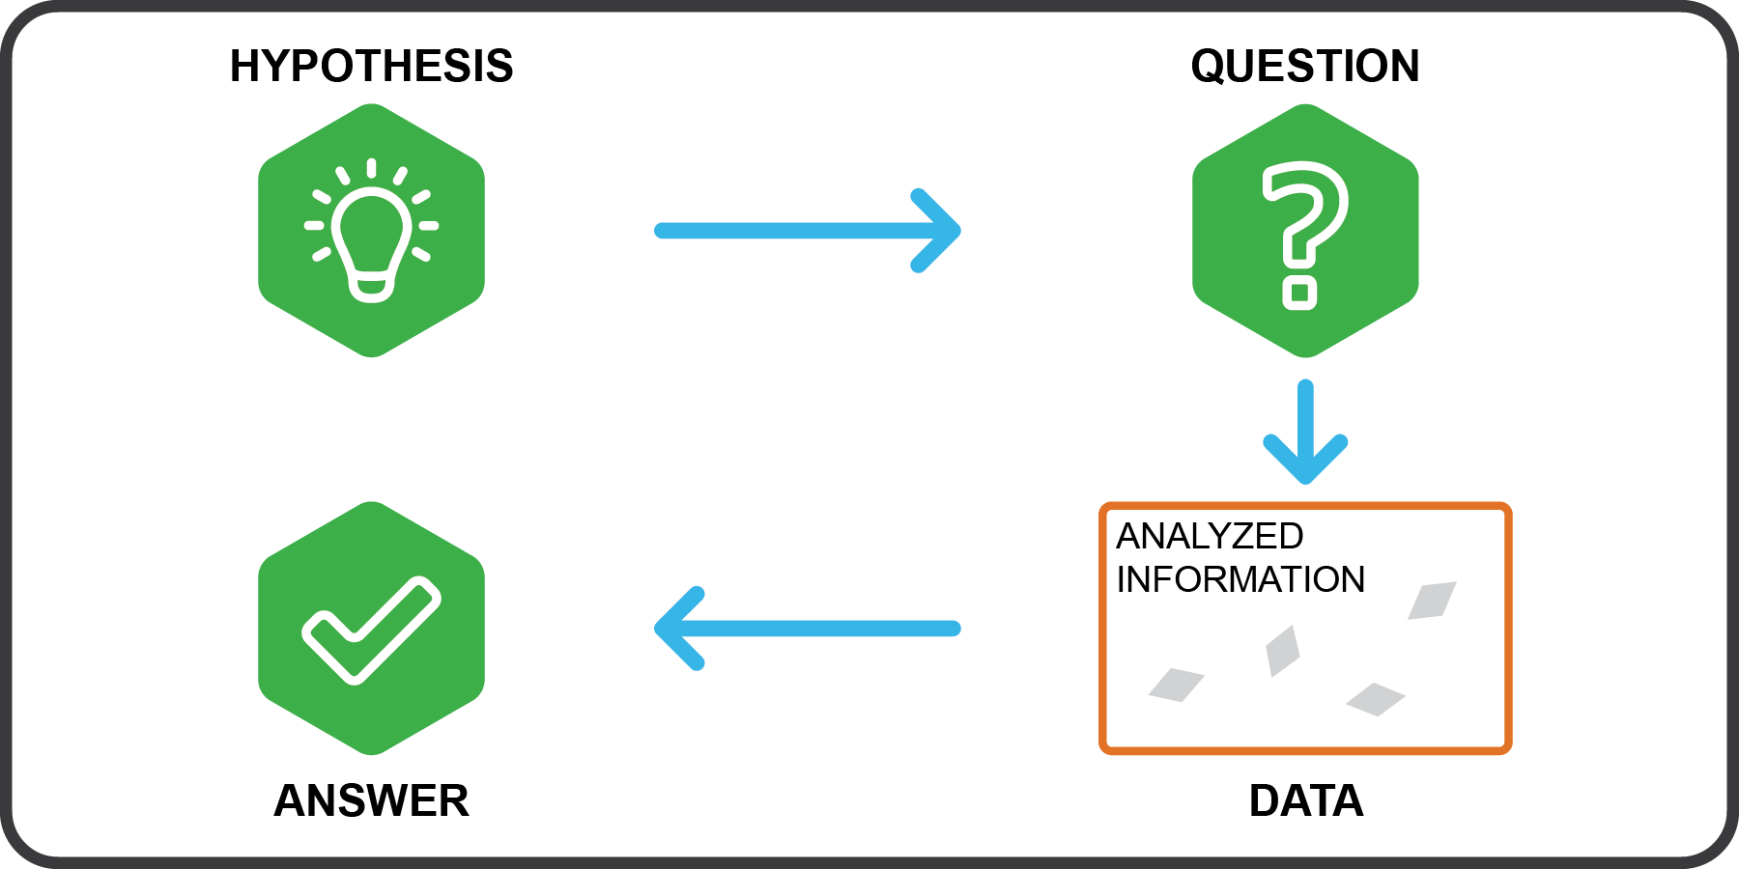
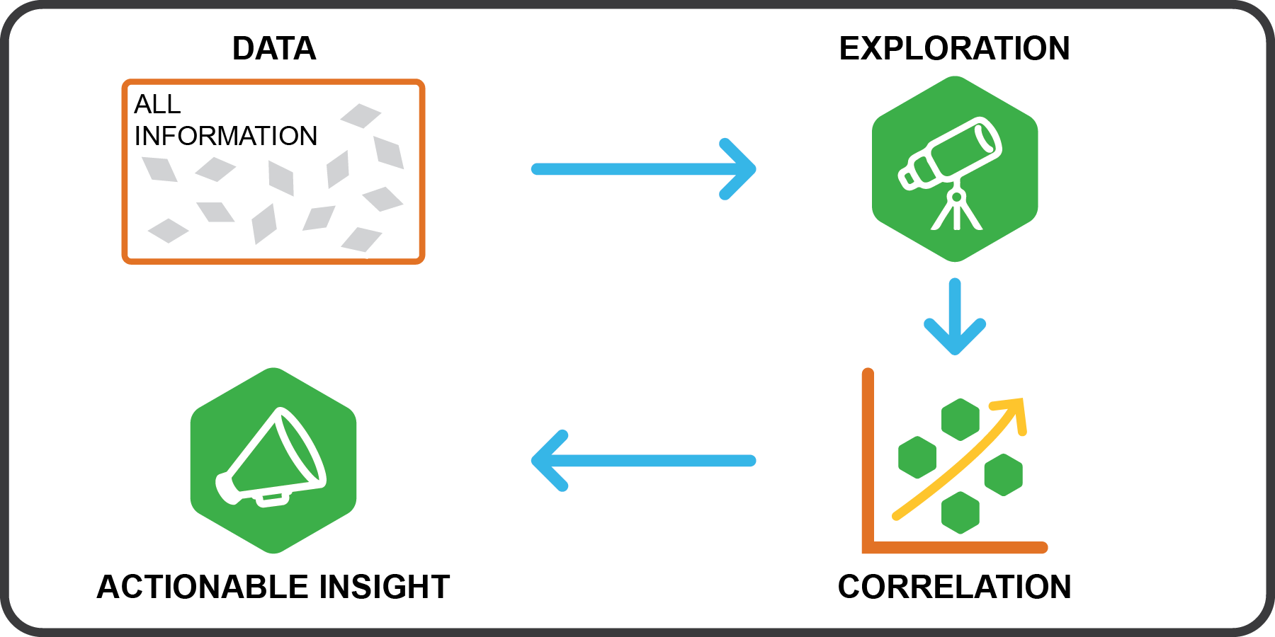
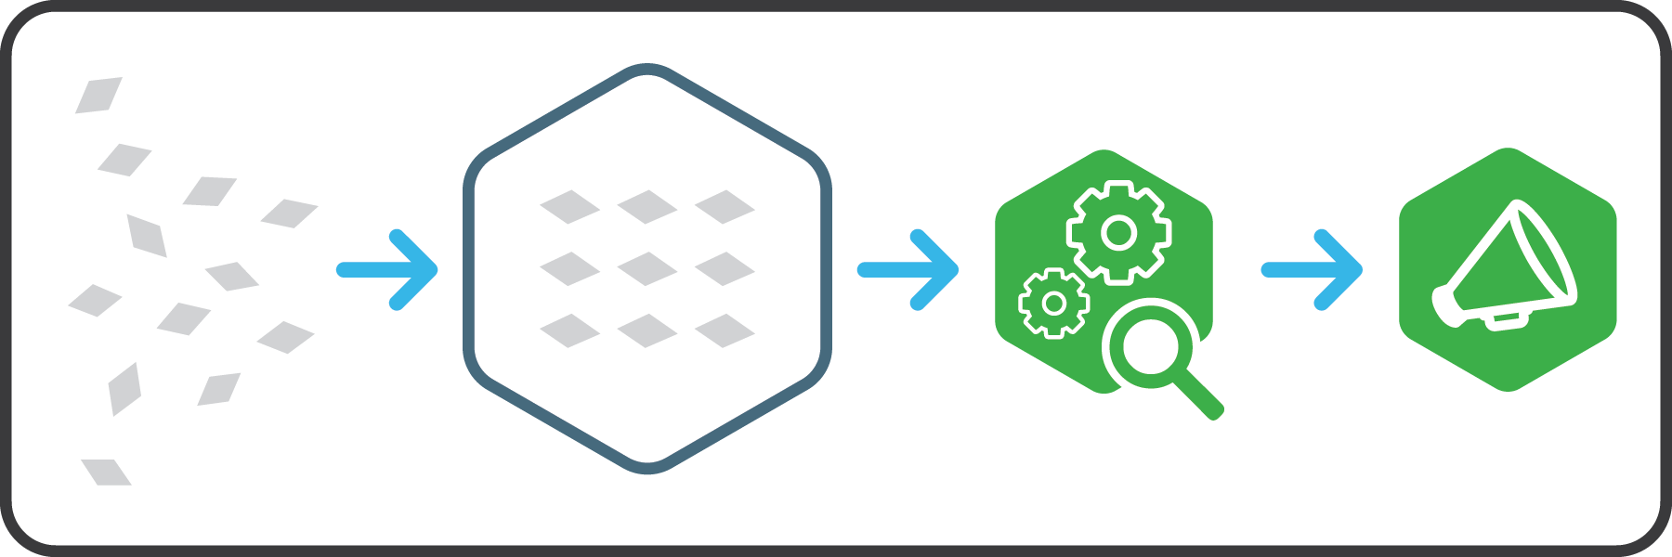
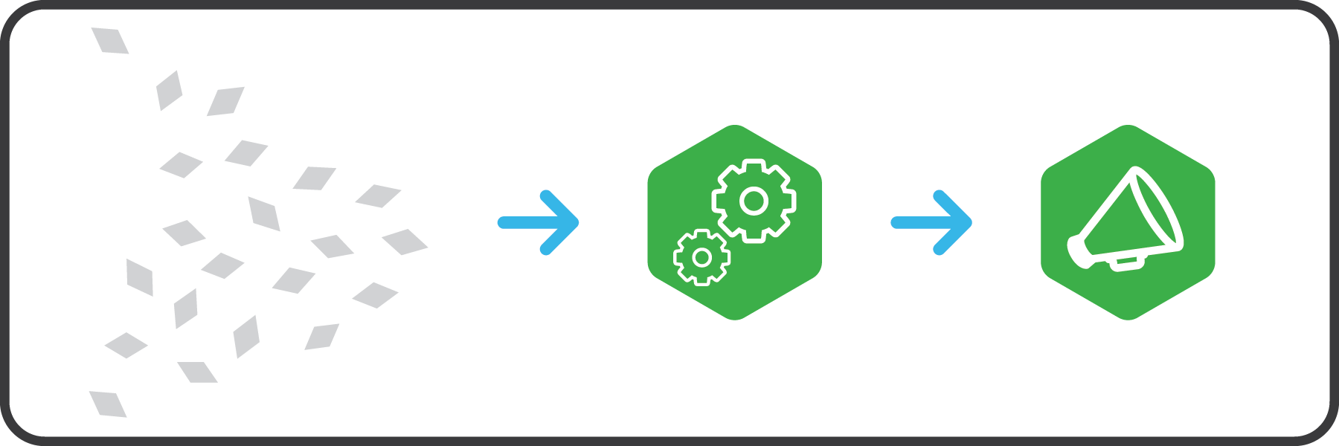
Modern Data Applications approach to Insights
Traditional Analytics Structured & Repeatable Structure built to store data
Next Generation Analytics Iterative & Exploratory Data is the structure
Start with hypothesis
Test against selected data
Data leads the way Explore all data, identify correlations
Analyze after landing…
Analyze in motion…
7

Slide 8
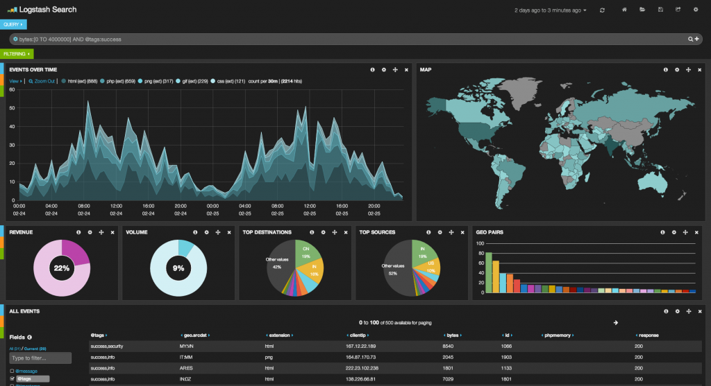





High-Level Overview
Live Dashboard
IoT Devices
IoT Edge
(single node)
NiFi Hub
Data Broker
Data Store
Column DB
HDFS/S3
HBase/Cassandra
IoT Devices
IoT Edge
(single node)
Data Center (on premises/cloud)
Notes:
NiFi: simple event processing
Spark: complex event processing
Build predictive model from Historical insights.
Deploy predictive model for real-time insights.

Slide 9
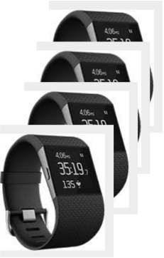
Use Case Description
Business Goal / Requirements
Company X wants to provide a Managed Service for patients/users who wants to be alerted when their resting heart rate increases past a certain configured threshold
Support any major wearable device in the market.

Slide 10
Apache Spark Streaming

Slide 11
Spark Ecosystem
Spark SQL
Spark Streaming
MLLib
GraphX
Spark Core

Slide 12
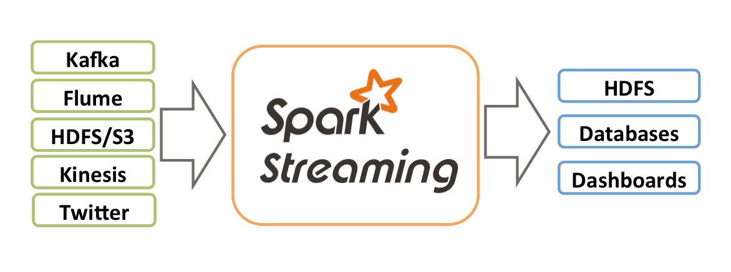
Spark Streaming
Overview
Extension of Spark Core API
Stream processing of live data streams
Scalable
High-throughput
Fault-tolerant
ZeroMQ
MQTT

Slide 13
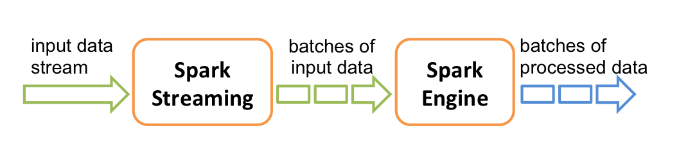
Spark Streaming
Notes:
Micro-batches (near-real time) vs Event based (Storm or Flink)

Slide 14
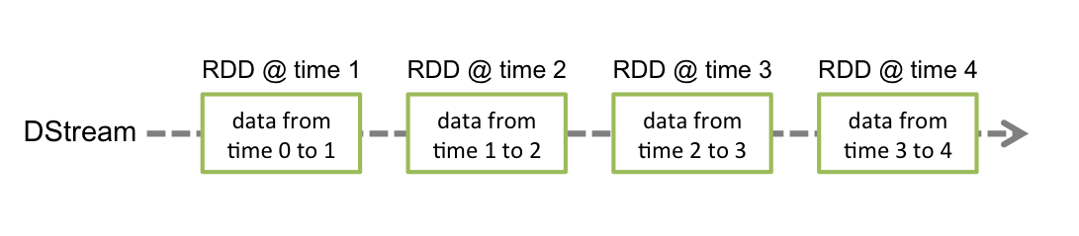
Spark Streaming
Discretized Streams (DStreams)
High-level abstraction representing continuous stream of data
Internally represented as a sequence of RDDs
Operation applied on a DStream translates to operations on the underlying RDDs

Slide 15
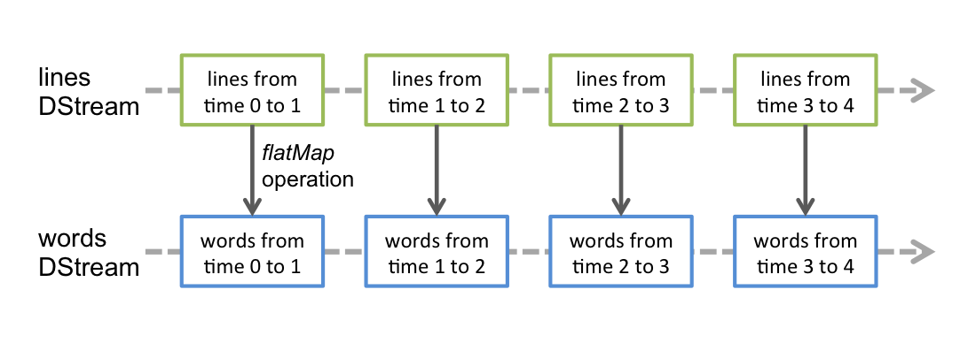
Spark Streaming
Example: flatMap operation

Slide 16
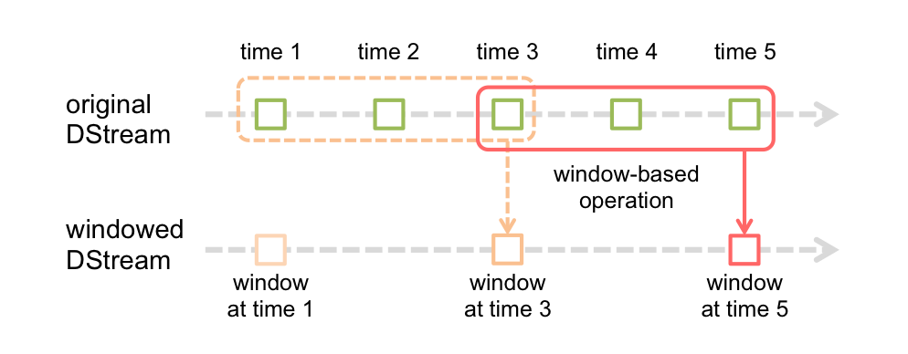
Spark Streaming
Window Operations
Apply transformations over a sliding window of data, e.g. rolling average

Slide 17
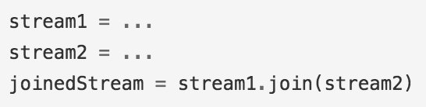
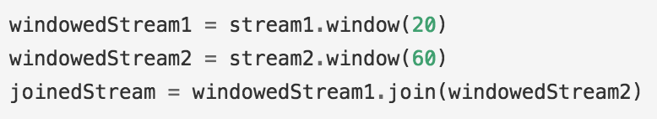
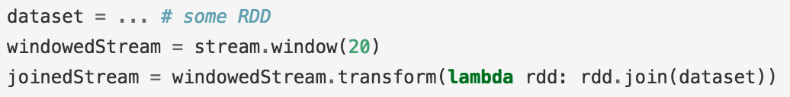
Join Operations

Slide 18
Streaming MLlib
Streaming Significance Testing (A/B Testing)
Streaming Linear Regression
Streaming K-means

Slide 19
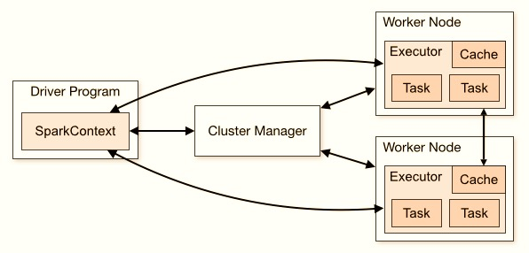
Checkpointing
When Apps Need to Operate 24/7
Recovery from system failures, JVM failures, etc.
Metadata Checkpointing ← driver failures recovery
Data Checkpointing ← saving generated RDDs to storage
Esp. relevant when data combined across batches i.e. when generated RDDs depend on RDDs from previous batches
Checkpointing is enabled by specifying a fault-tolerant storage (HDFS, S3, …)

Slide 20
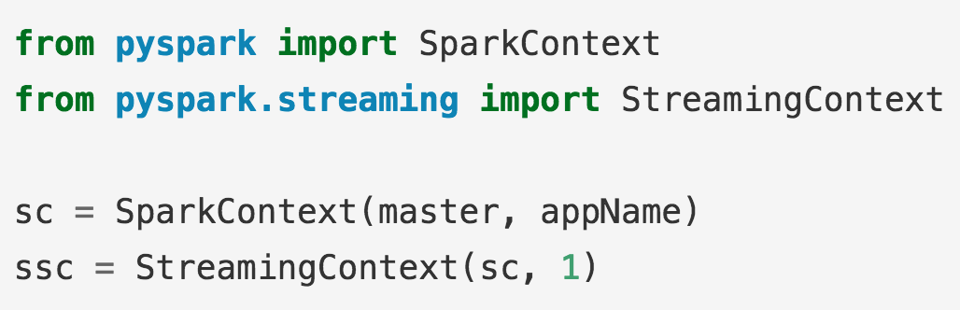
Initialize Streaming Context

Slide 21
Apache Kafka

Slide 22

Kafka
Cluster
Producer 1
Broker 1
Consumer 1
Broker 2
Consumer 2
Producer 2
Broker 3
Consumer 3

Slide 23
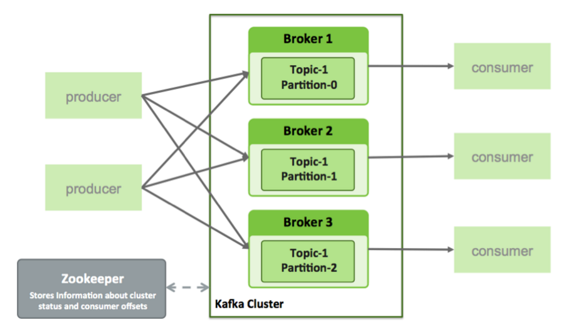
Kafka Architecture

Slide 24
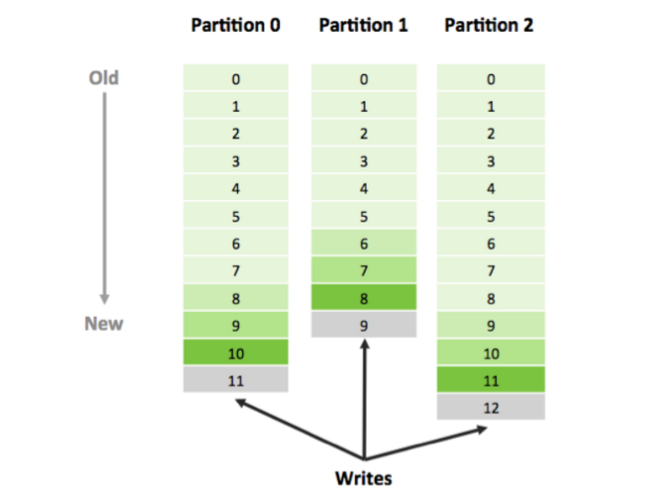
Kafka Architecture

Slide 25
Apache Kafka
FAST
Single Kafka broker: 100s of MB/s read/write from 1000s of clients
SCALABLE
Single cluster as central backbone to entire organization
Elastically & transparently expanded w/o downtime
Data streams partitioned & spread over a cluster of machines
DURABLE
Messages persisted to disk & replicated to prevent data loss

Slide 26
Kafka-Spark Connector Types
Receiver Approach
Data from Kafka stored in Spark Executors
Data may be double-counted when using Write Ahead Logs for resiliency
Direct Approach (Spark 1.4+ all APIs)
Exactly-once semantics
Simplified
No need for Write Ahead Logs or Zookeeper
See Kafka Integration Guide for more info.
Use this one!
*up to 15x faster throughput
*Source: http://www.slideshare.net/SparkSummit/grace-huang-49762421

Slide 27
import sys
from pyspark import SparkContext
from pyspark.streaming import StreamingContext
from pyspark.streaming.kafka import KafkaUtils
sc = SparkContext(appName="kafkaTest")
ssc = StreamingContext(sc, 5)
kvs = KafkaUtils.createStream(ssc, "localhost:2181", "spark_streaming", {"inter_transact": 1})
# APPLY OTHER TRANSFORMATIONS HERE
kvs.pprint(10)
ssc.start()
ssc.awaitTermination()

Slide 28
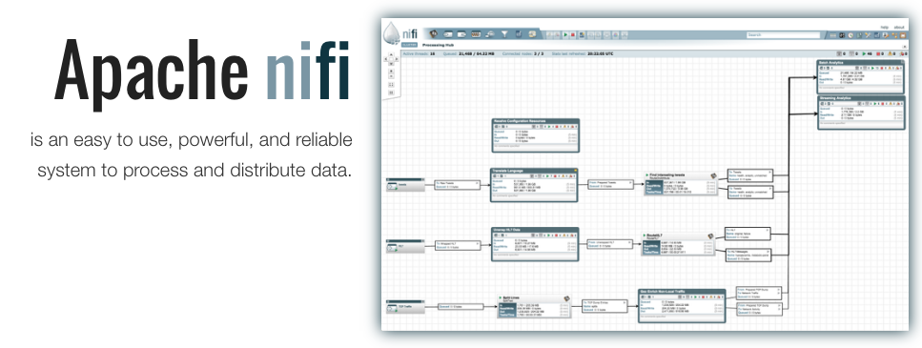

Slide 29
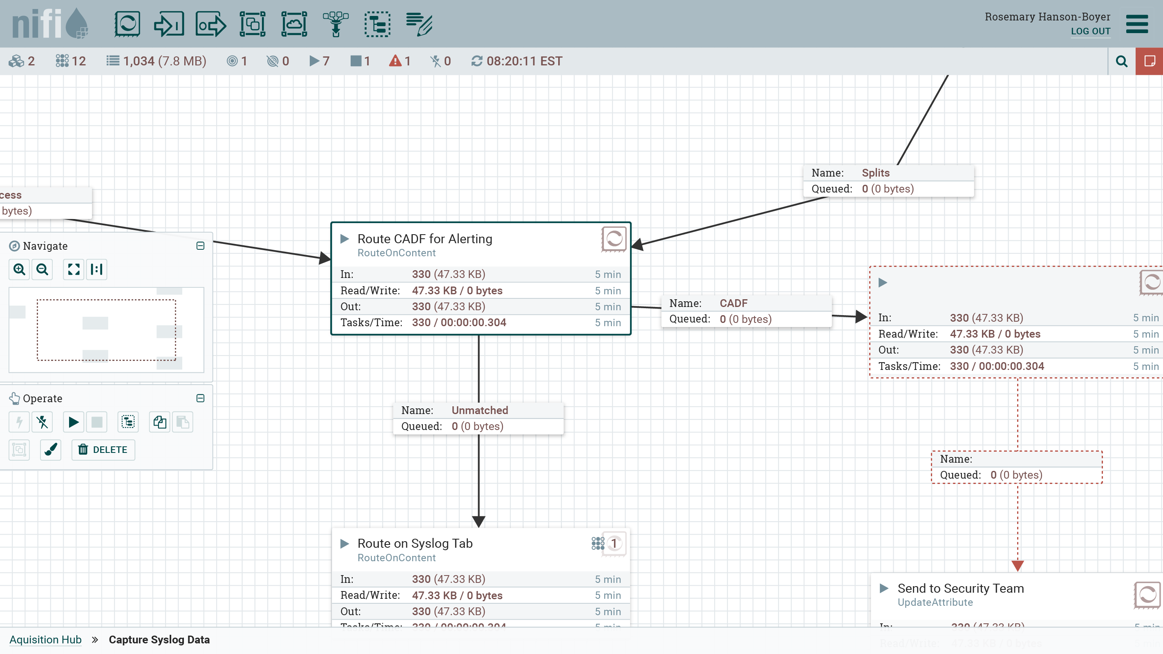
Apache NiFi High Level Capabilities
Web-based user interface
Design, control, feedback & monitoring
Highly configurable
Loss tolerant vs guaranteed delivery
Low latency vs high throughput
Dynamic prioritization
Flow can be modified at runtime
Back pressure
Data provenance
Track dataflow from beginning to end
Designed for extension
Build your own processors
Secure
SSL, SSH, HTTPS, etc.

Slide 30


















Deeper Ecosystem Integration: 170+ Processors
FTP
Hash
Encrypt
GeoEnrich
SFTP
Merge
Tail
Scan
HL7
Extract
Evaluate
Replace
UDP
Translate
Duplicate
Execute
XML
Split
Convert
HTTP
Route Text
Email
Route Content
HTML
Route Context
Image
Control Rate
Syslog
Distribute Load
AMQP

Slide 31

Apache NiFi Subproject: MiNiFi
Let me get the key parts of NiFi close to where data begins and provide bi-drectional communication
NiFi lives in the data center. Give it an enterprise server or a cluster of them.
MiNiFi lives as close to where data is born and is a guest on that device or system

Slide 32


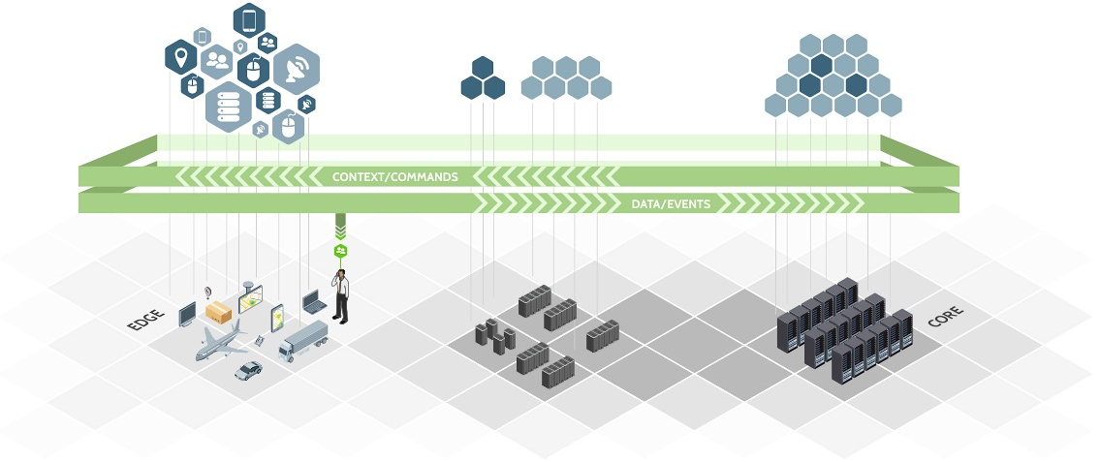
Apache NiFi Managed Dataflow
SOURCES
REGIONAL INFRASTRUCTURE
CORE INFRASTRUCTURE

Slide 33
Review
Live Dashboard
IoT Devices
IoT Edge
(single node)
NiFi Hub
Data Broker
Data Store
Column DB
HDFS/S3
HBase/Cassandra
IoT Devices
IoT Edge
(single node)
Data Center
(on prem/cloud)

Slide 34
DEMO INSTRUCTIONS http://tinyurl.com/hwx-intro-to-spark-streaming
DEMO

Slide 35
Final Comments

Slide 36
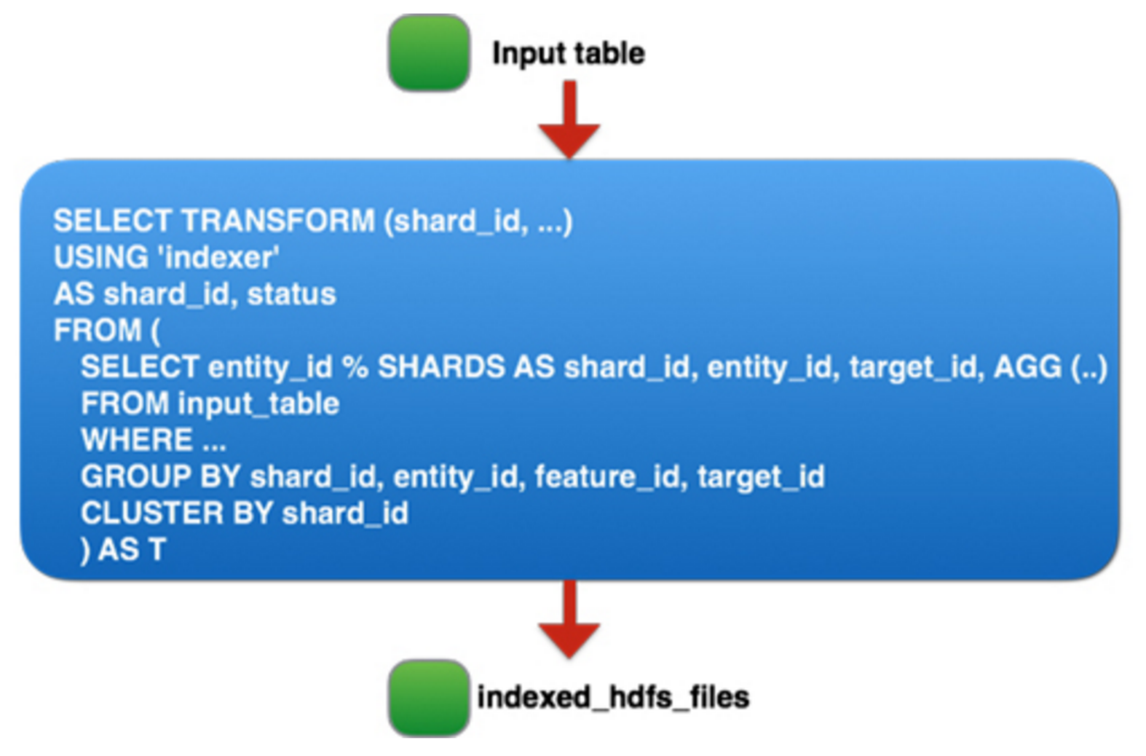
Facebook Engineering Blog on Spark Deployment
Spark job that reads 60 TB of compressed data and performs a 90 TB shuffle and sort.
Largest real-world Spark job to date!
Databricks’ PetaByte sort was on synthetic data.
Multiple reliability fixes.
Spark job that reads 60 TB of compressed data and performs a 90 TB shuffle and sort.
Largest real-world Spark job to date!
Databricks’ PetaByte sort was on synthetic data.
Multiple reliability fixes.
“Spark could reliably shuffle and sort 90 TB+ intermediate data and run 250,000 tasks in a single job […] and it has been running in production for several months.”
Notes:
Source: Facebook Eng. Blog: http://bit.ly/2cJaIrf

Slide 37
Thanks! T: @RobH8z E: rhryniewicz@hortonworks.com

